Slide 1

Sogang University Embedded System Software Project Presentation

Slide 2
1. Outline

Slide 3

Subject
Java
Native
Interface
Puzzle Game
Hardware
Abstract
Layer

Slide 4
2. Implementation

Slide 5
Android Software Stack

Slide 6
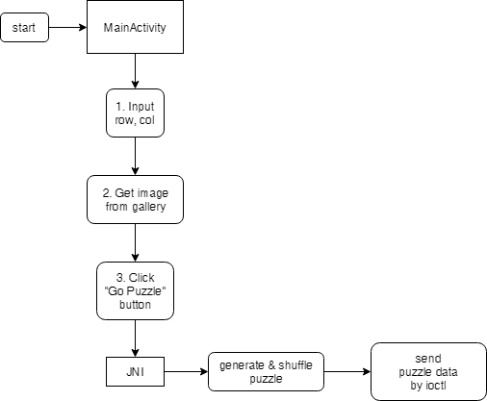
Application Flowchart

Slide 7
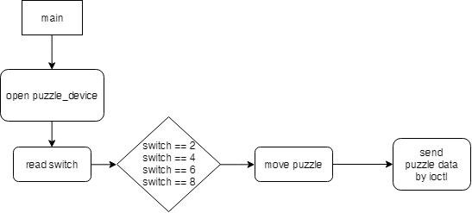
Daemon Flowchart
Where??

Slide 8
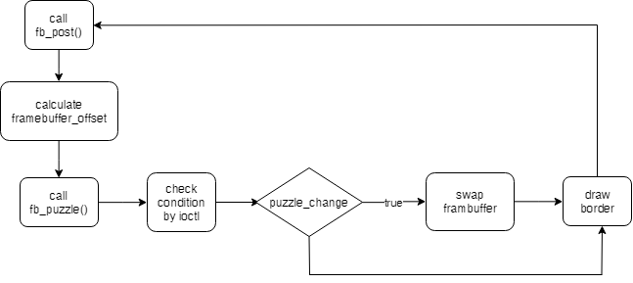
Framebuffer Flowchart

Slide 9
3. Detail

Slide 10
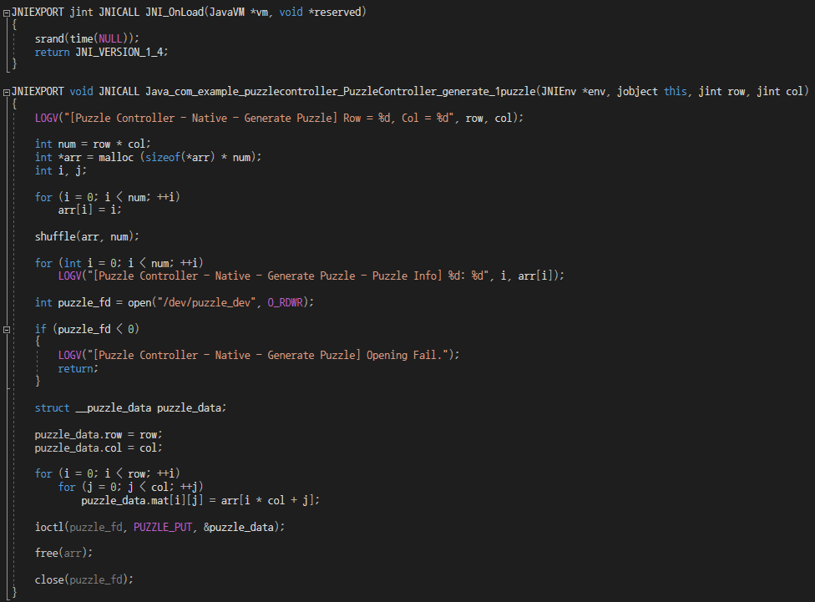
Code (JNI)

Slide 11
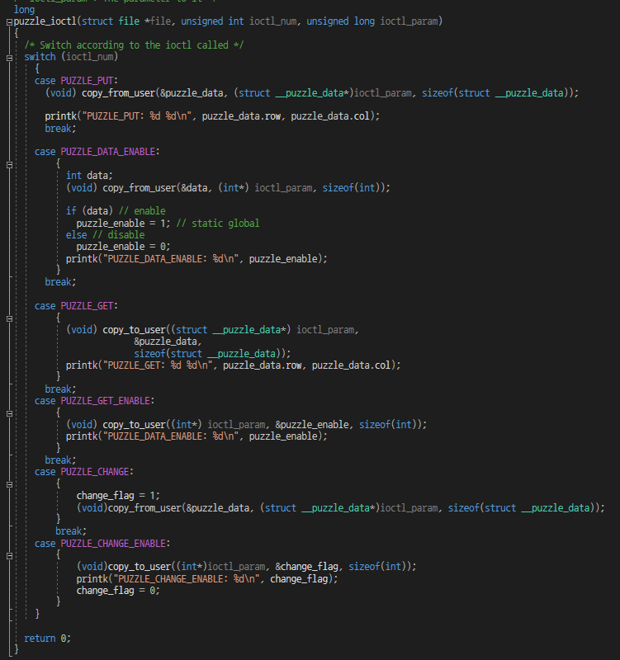
Code (puzzle_dev)

Slide 12
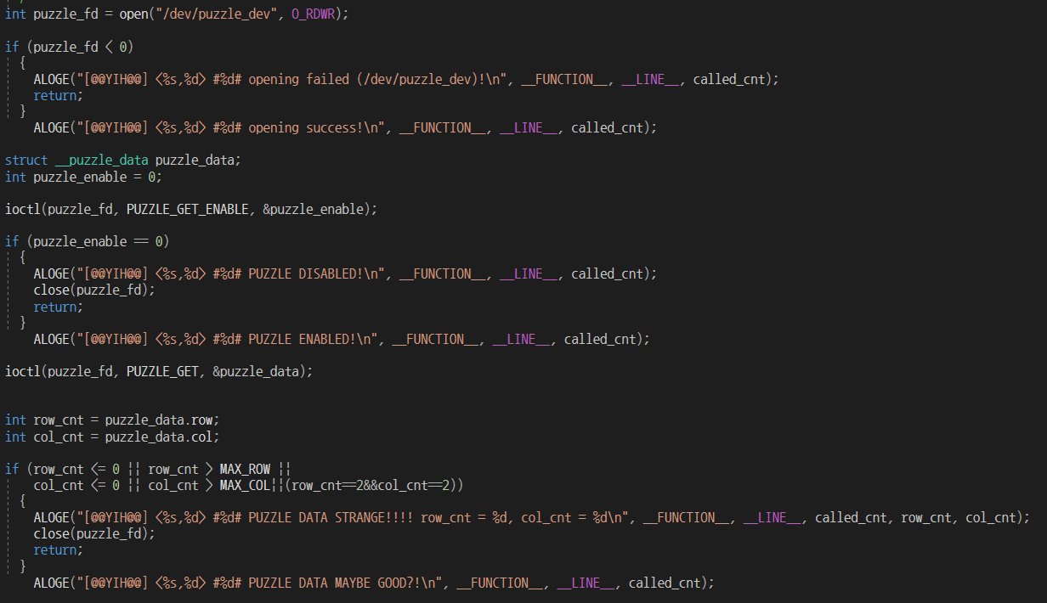
Code (Framebuffuer)

Slide 13
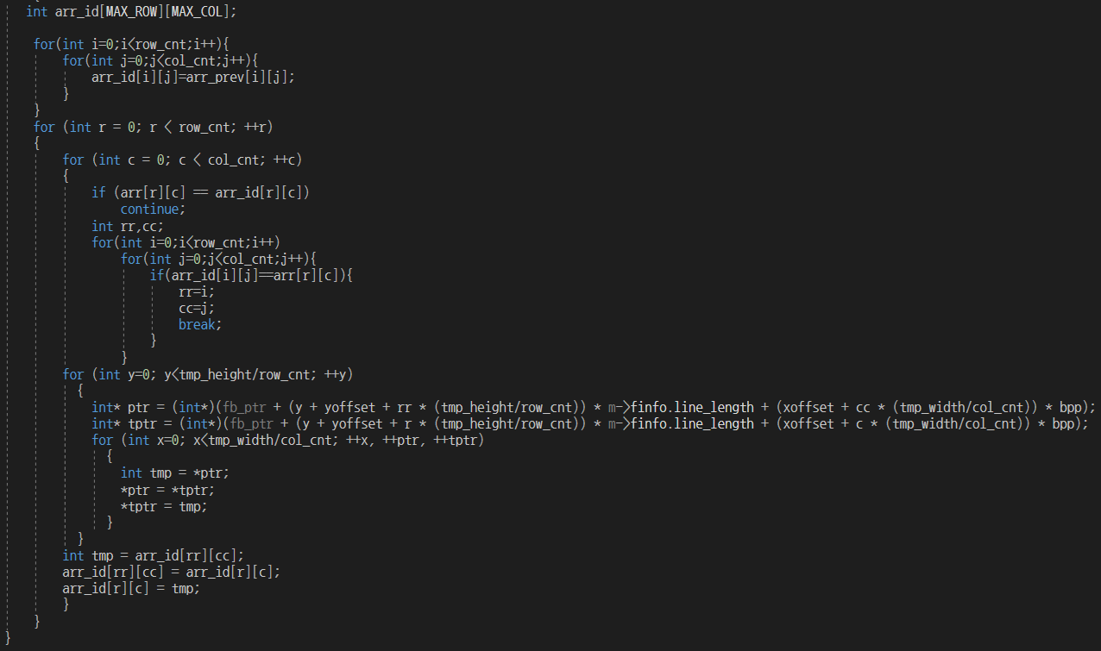
Framebuffuer (continue)

Slide 14
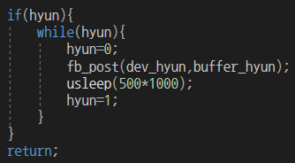
Framebuffuer (continue)
Why?

Slide 15
4. Demonstration

Slide 16
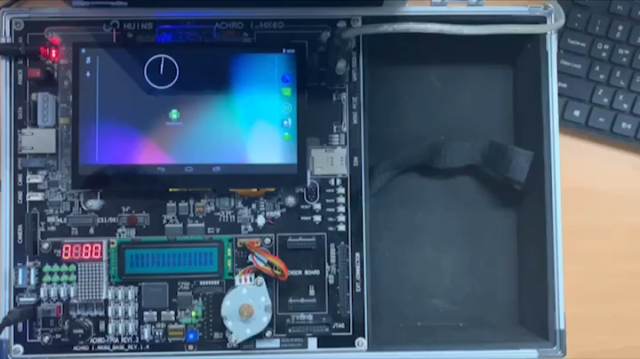
Demo

Slide 17
Q & A

Slide 18
감사합니다.

